Slide 1
Finn Family Moomintroll
Moomin Gallery of Characters

Slide 2
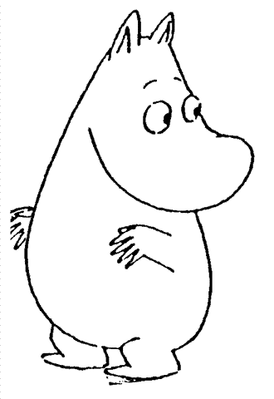
Moomintroll

Slide 3
As gullible as he is enthusiastic, he is also very young and extremely good-natured.
gullible - easy to fool
enthusiastic - excited
good-natured - cheerful

Slide 4
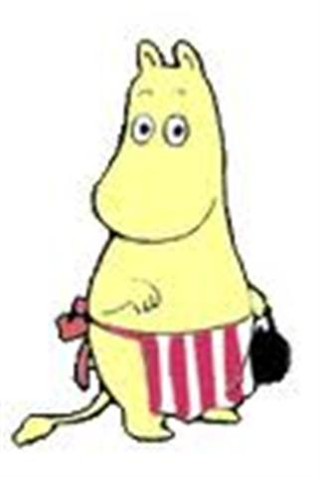
Moominmamma

Slide 5
The center of the family, highly moral but broad-minded.
moral - honest, good.
broad-minded - accepts others as they are

Slide 6
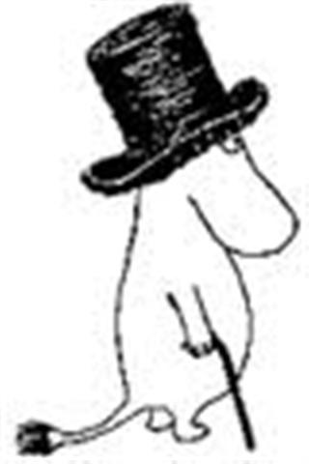
Moominpappa

Slide 7
A storyteller and a dreamer, and very loyal to his family and friends
loyal - dependable

Slide 8
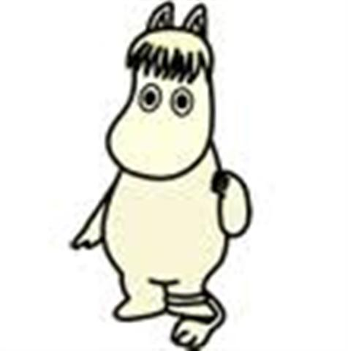
The Snork Maiden

Slide 9
Moomintroll’s friend and very occupied with romantic ideas.
occupied - always thinking about something
romantic: - dreamy, daydreaming

Slide 10
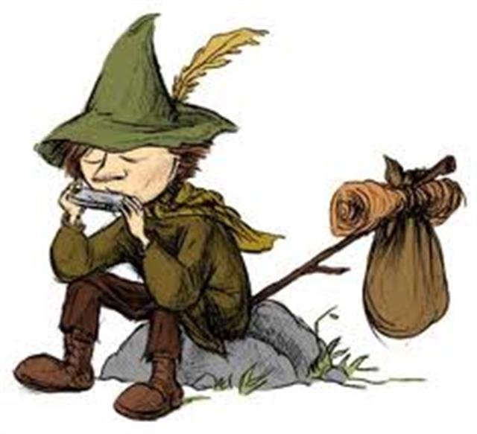
Snufkin

Slide 11
A vagabond, a musician, and Moomintroll’s best friend.
vagabond – one who roams around from place to place

Slide 12
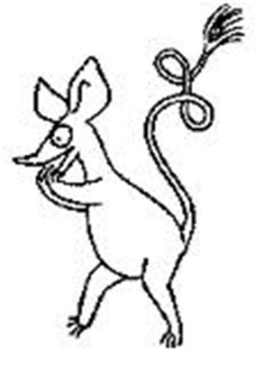
Sniff

Slide 13
An adopted friend of the family, his main interest is accruing riches such as gemstones.
accruing – collecting
gemstones – jewelry or shiny things

Slide 14
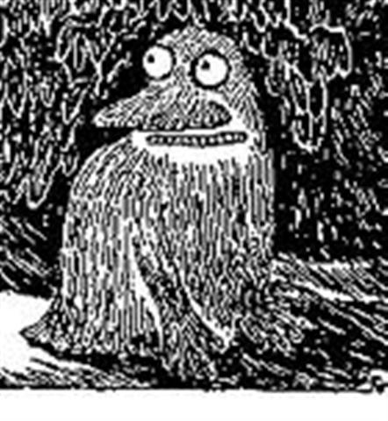
The Groke

Slide 15
The terror of the neighborhood, the unmentionable horror.
terror – something scary
unmentionable – cannot be talked about
horror – a terrible, scary thing

Slide 16
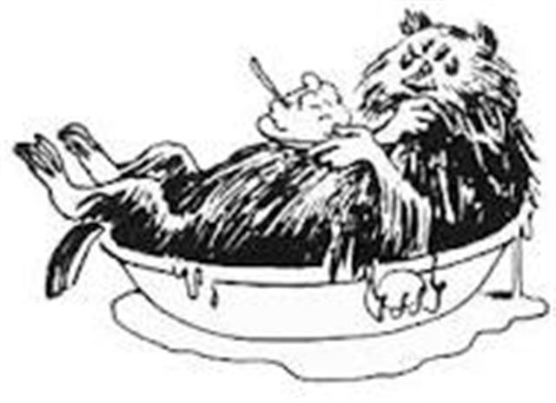
The Muskrat

Slide 17
Would-be philosopher, likes to be left in peace
would-be – working on becoming something
philosopher – thinker and dreamer
left in peace- left alone

Slide 18
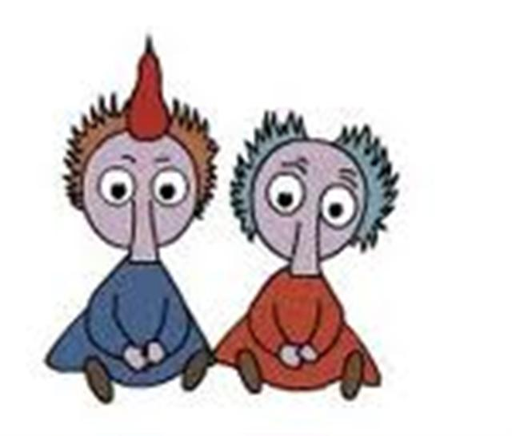
Thingumy and Bob

Slide 19
A mischievous pair, too fond of pea-shooters and such
mischievous – naughty, not well behaved
pea-shooters – a straw used to blow peas or spit wads at people.

Slide 20
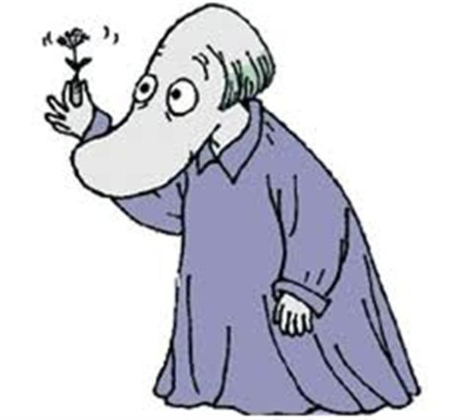
The Hemulen

Slide 21
Fantastic collector of stamps and plants
fantastic – unbelievable, out of this world
collector – someone who finds and keeps things

Slide 22
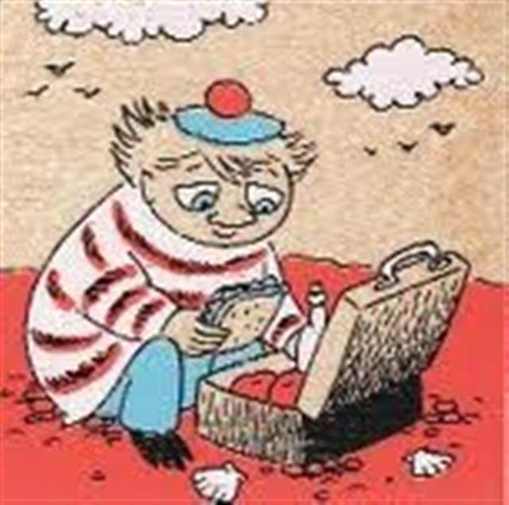
Too-Ticky

Slide 23
Her common sense often restores order to the valley.
common sense – good choices and good advice
restores – brings back
order – everything in the right place, everyone doing the right thing

Slide 24
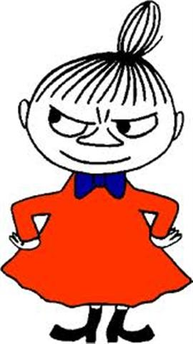
Little My

Slide 25
The family’s small, disrespectful, yet extremely positive friend.
disrespectful- rude
extremely – very; really
positive – encouraging; helpful

